Slide 1

The era of Netflix

Slide 2
Project Team
Ahmad Abo Alafa
Loic Tiemani
Hazim Hamadne
Hamid Zarringhalam

Slide 3
Purpose of the Project
In this project we have analyzed Netflix Movies and TV shows based on their Ratings, Countries, Budgets, and Revenues.
Gathering these data was based on API connection to OMDB and TMDB.
https://www.kaggle.com/shivamb/netflix-shows?select=netflix_titles.csv
Public movie APIs:
OMDB - OMDb to obtain information and metadata about movies.
http://www.omdbapi.com/?apikey={api_key}&t=
TMDb - TMDb for movie discovery.
https://api.themoviedb.org

Slide 4
Type of Data we worked with
The kind of data we worked with is Netflix data till year 2019

Slide 5
questions we have asked of the data
Understanding what content is available in different countries
*Based on genre
Network analysis of Actors / Directors and find interesting insights
*Pair of actors/directors appears together in most movies
Is Netflix has increasingly focusing on TV rather than movies in recent years.
*Number of TV vs Movies per year
Graph of the countries that contribute producing movies for NetFlix
*Heat graph for number of movies
Using API to enrich the movies data getting more information about the
movie such as Reviews, Rating, top rated, the budget for the Movie and the total money that the movie has generated
*Top rated movies
**Rating vs revenue
**Genre vs revenue

Slide 6
questions we have asked of the data
the total money that the movie has generated
*Top rated movies
**Rating vs revenue
**Genre vs revenue
Revenue based on different countries
*Country vs revenue
Revenue vs budget
Revenue per season
Ratio of genres
Top 20 titles with highest revenue.
Relation between award wining and revenue

Slide 7
questions we have asked of the data
Revenue based on different countries
*Country vs revenue
Revenue vs budget
Revenue per season
Ratio of genres
Top 20 titles with highest revenue.
Relation between award wining and revenue

Slide 8
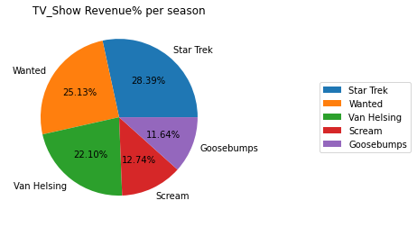
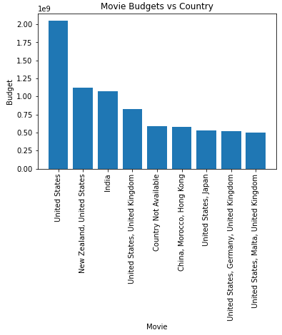
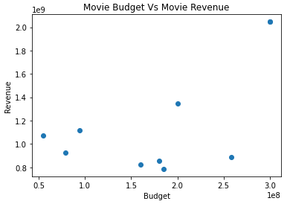
API Connections

Slide 9
